Slide 1
Technical Project Overview
ozmath.com
Benjamin Chau

Slide 2
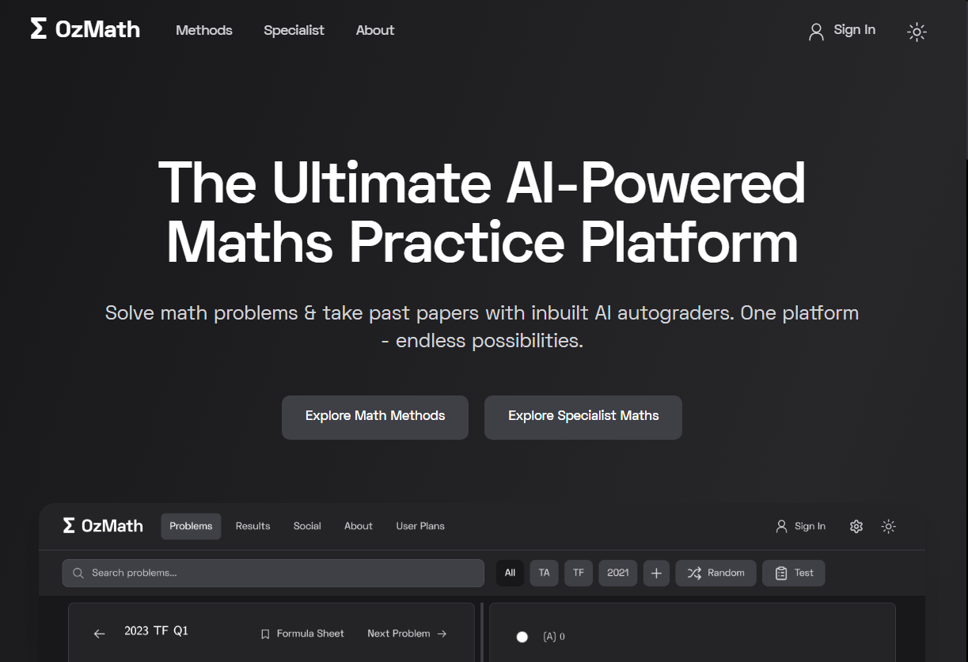
Purpose, Aim, Audience
Platform for QCAA mathematics students to prepare for exams & solidify content through problem-based learning
A way for me to present and build on my two interests – mathematics and full-stack development
Platform with potential to expand into assisting IB, VCE & HSC students
Fig. 1: Home Page, Desktop POV

Slide 3
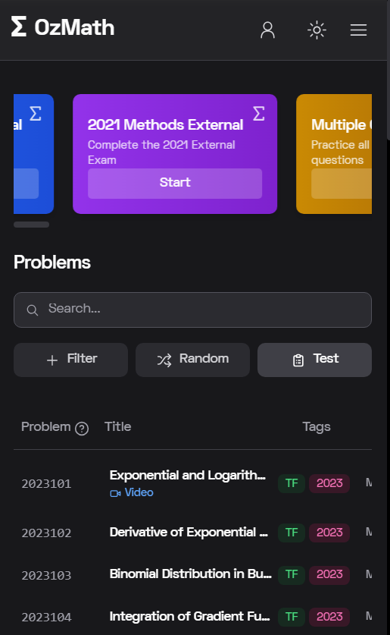
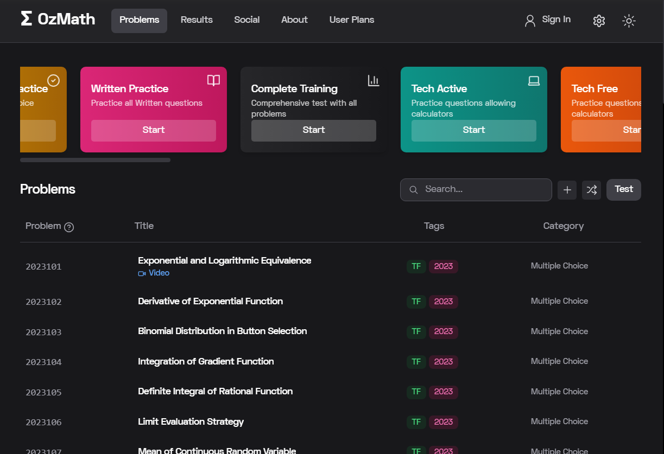
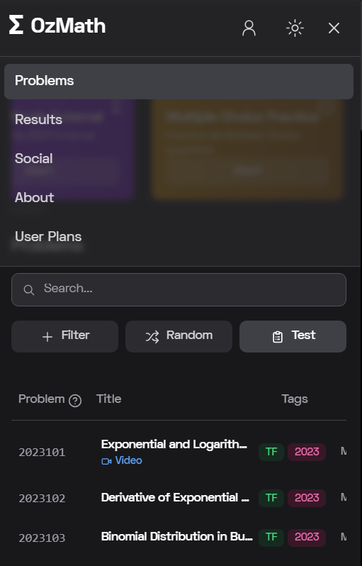
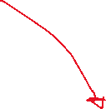


Intuitive, device-compatible UI
Dark/light mode support
Search problems, filter problems, select random problem & Test function (featured Page 6)
Fig. 2: Methods Home Page, Desktop POV
Fig. 3: Methods Home Page + TopBar Dropdown, Mobile POV

Slide 4
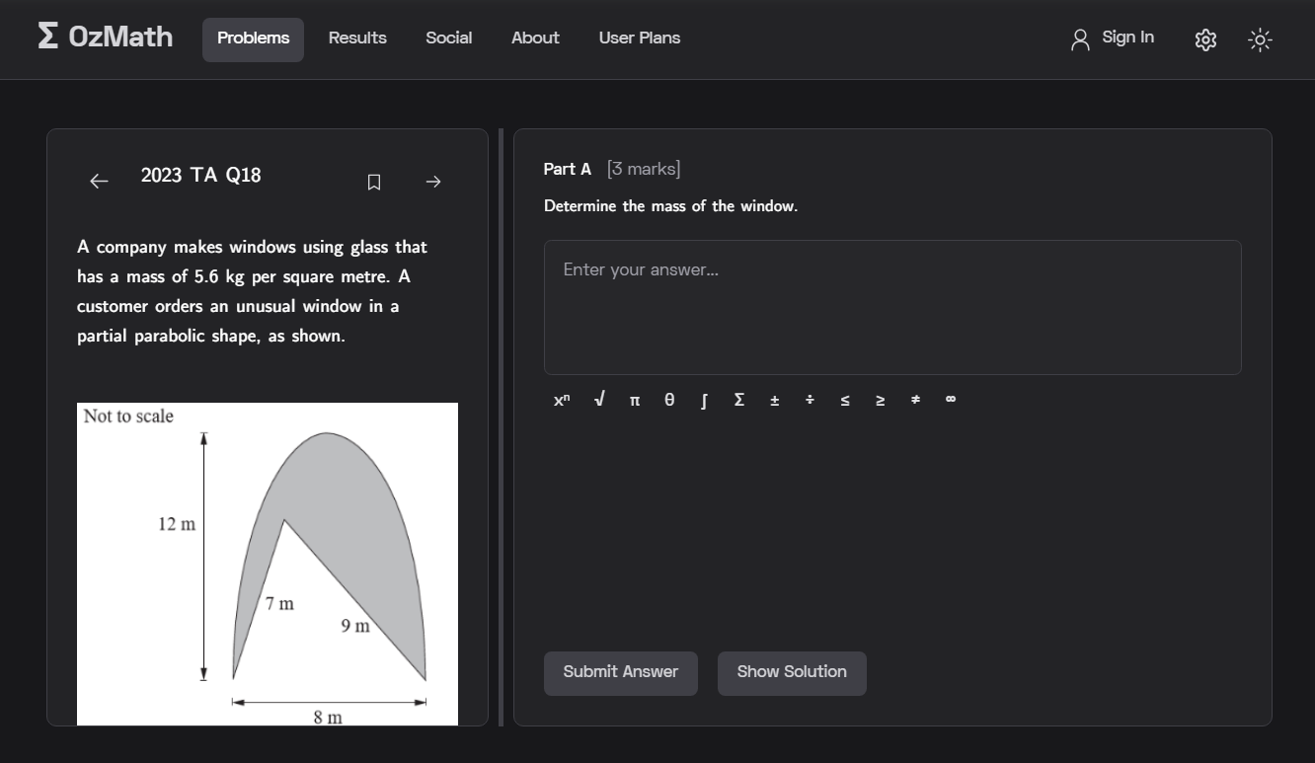
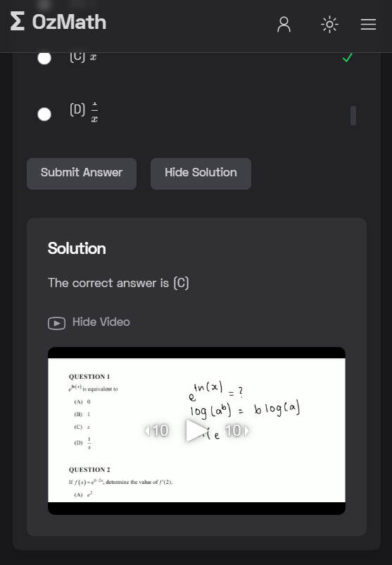

Accurate answering & grading system (1)
Detailed, subtitled solutions
Adjustable Slider
(DOM integration)
MathQuill integration
Fig. 4: Problem view, Desktop POV
Fig. 5: Problem view, Mobile POV

Slide 5
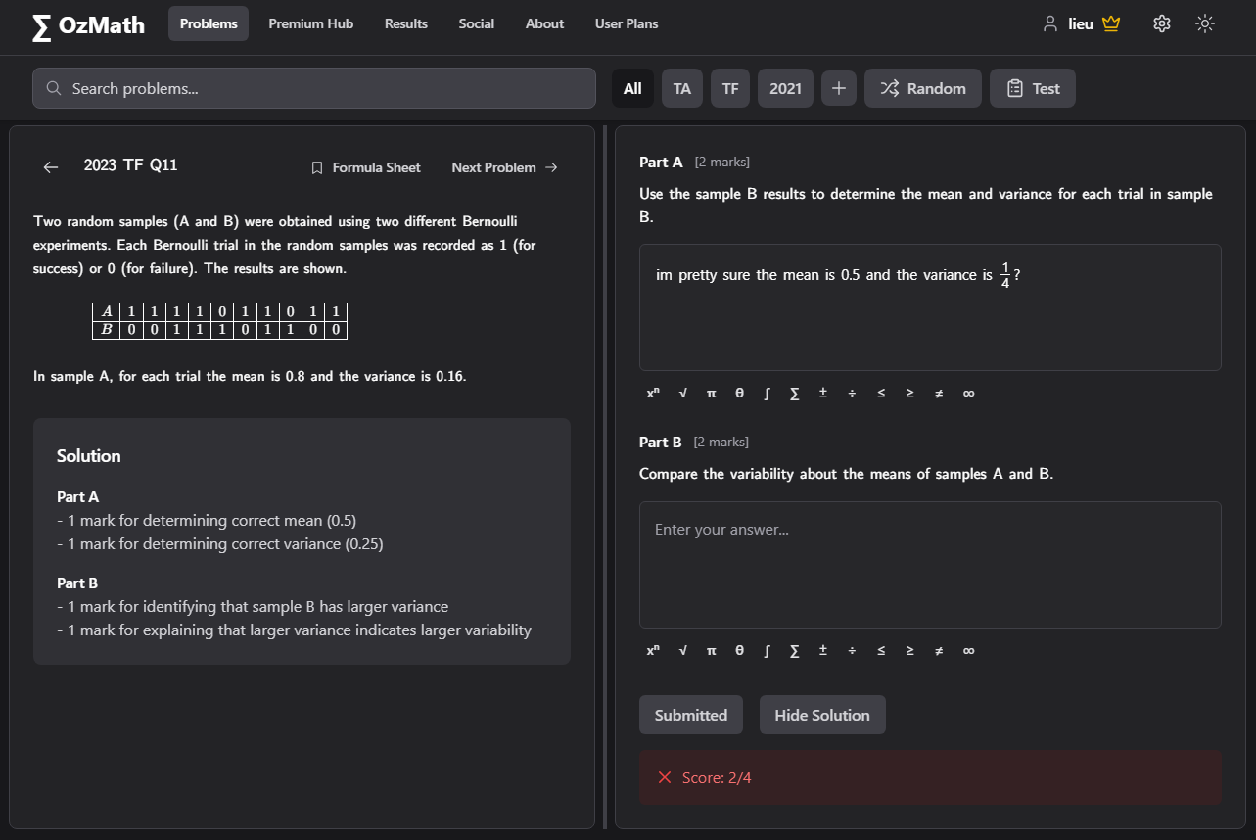
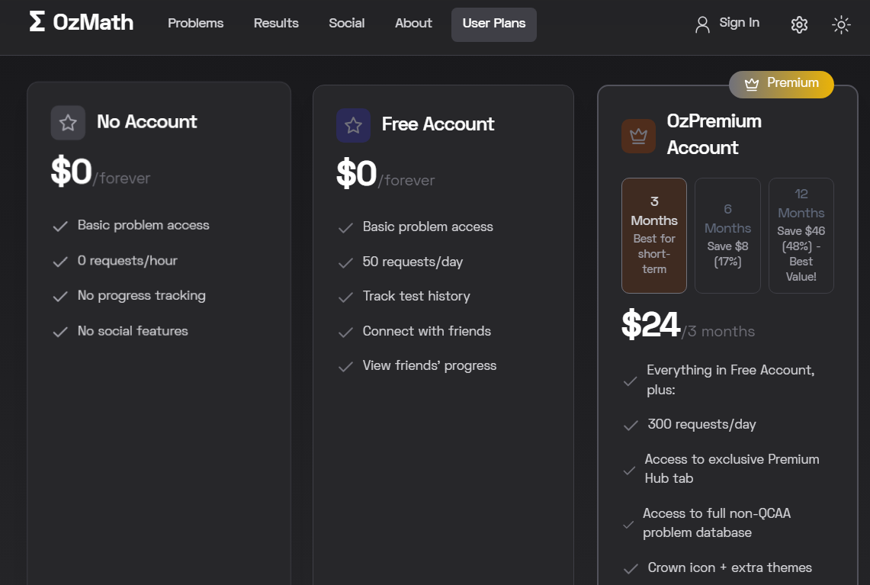

Accurate answering & grading system (2)
Limited API requests – mitigating spam & misuse
Integrated OpenAI API (GPT 4-Turbo) to grade user responses based off QCAA solution
Fig. 7: User Plans Page, Tablet POV
Fig. 6: Problem view, Desktop POV

Slide 6
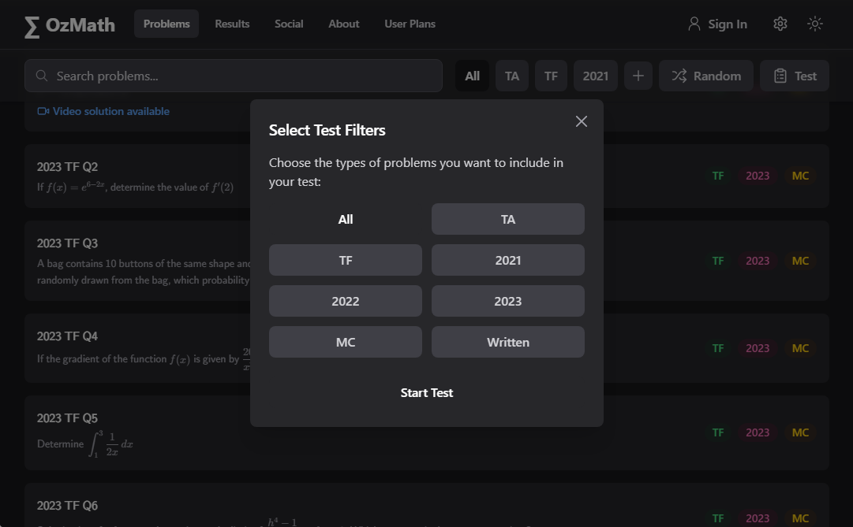
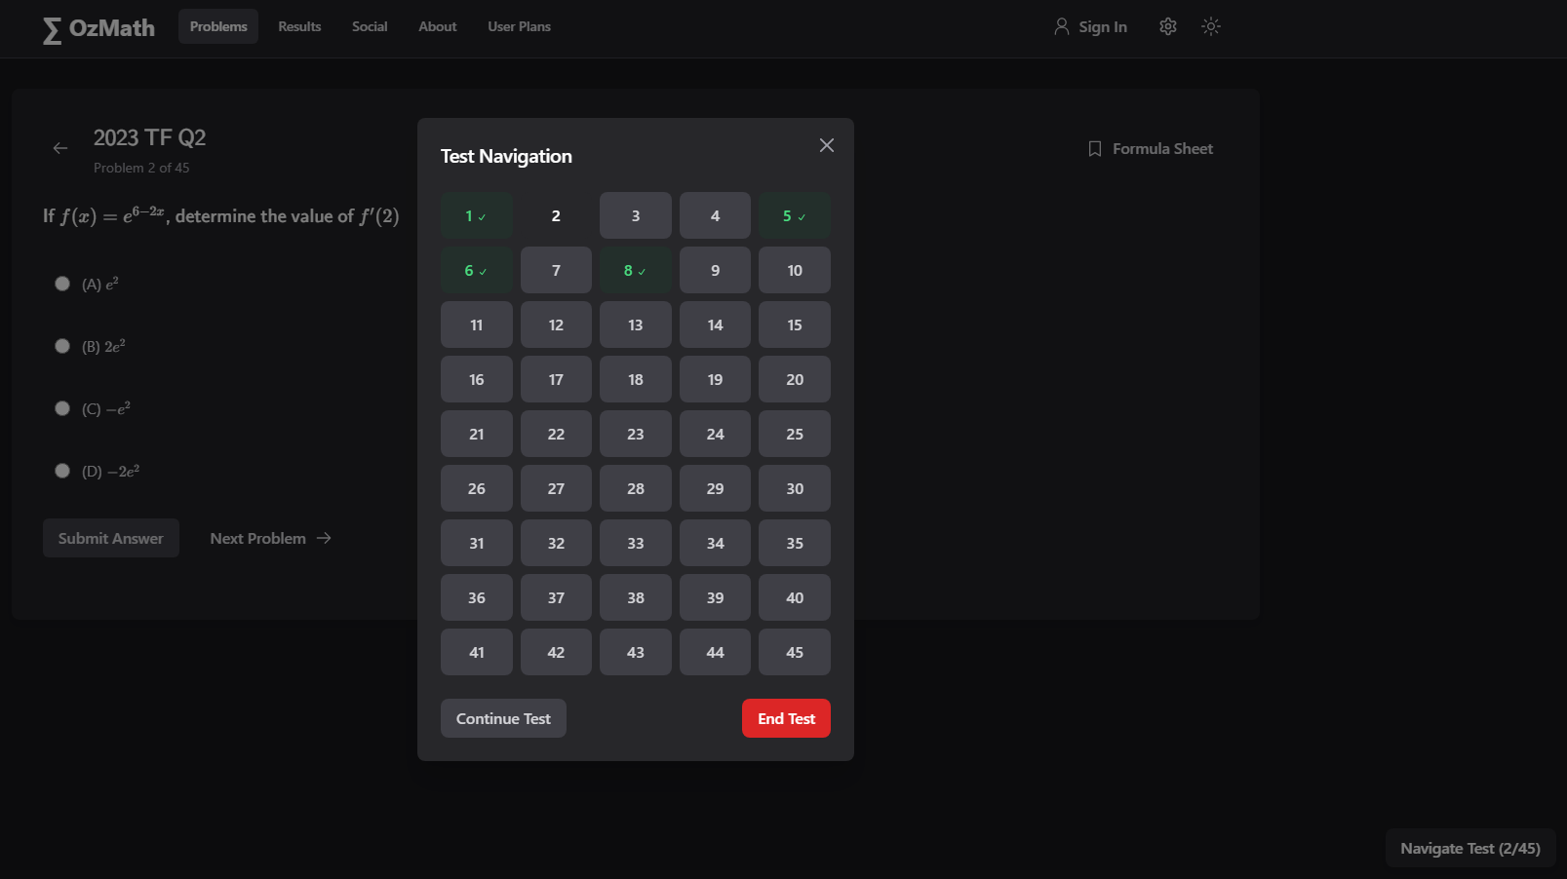



Testing system (1)
Practice using Test function, filter problems before testing
Fig. 8: Test Modal, Tablet POV
Navigate problems during test
Fig. 9: Test Navigation Modal, Desktop POV

Slide 7
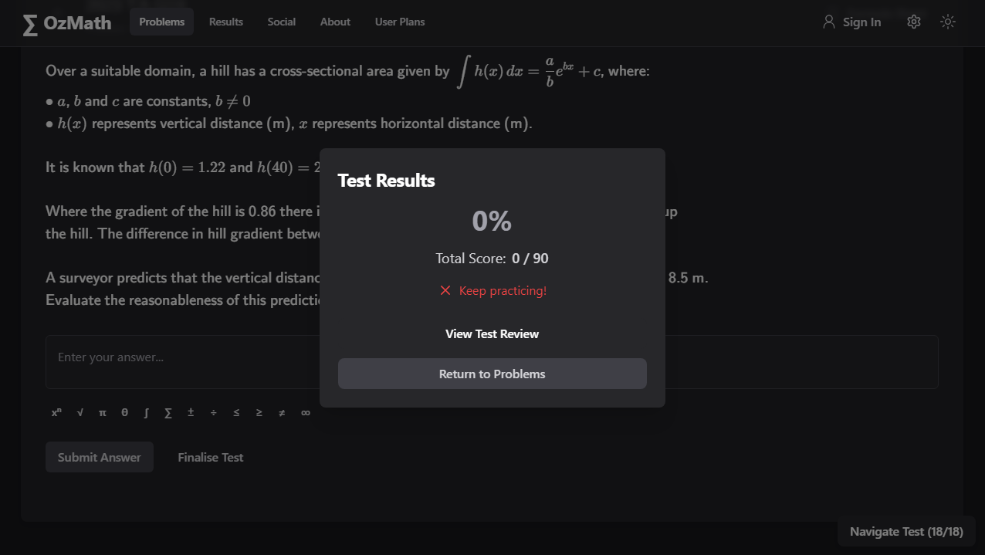
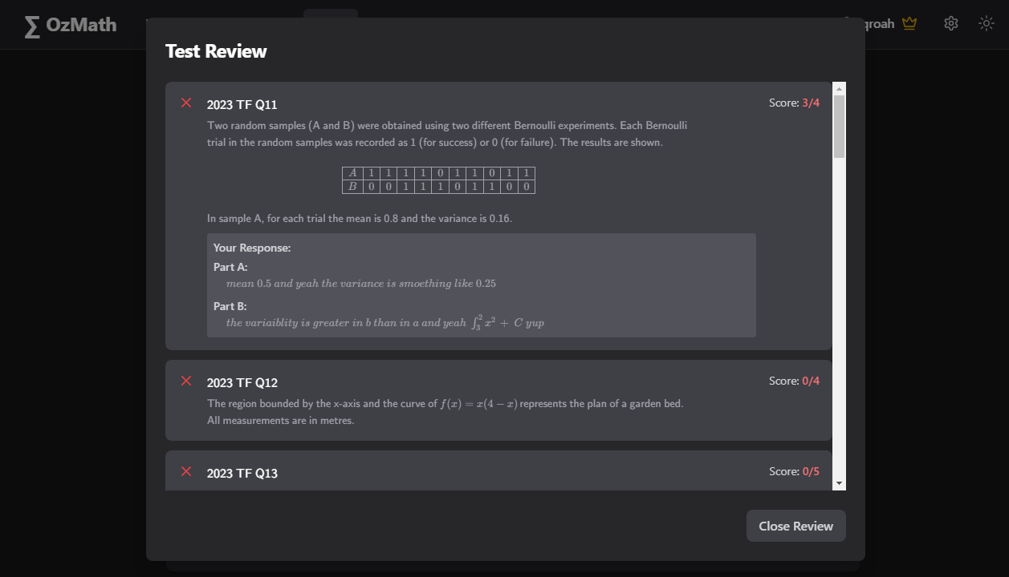
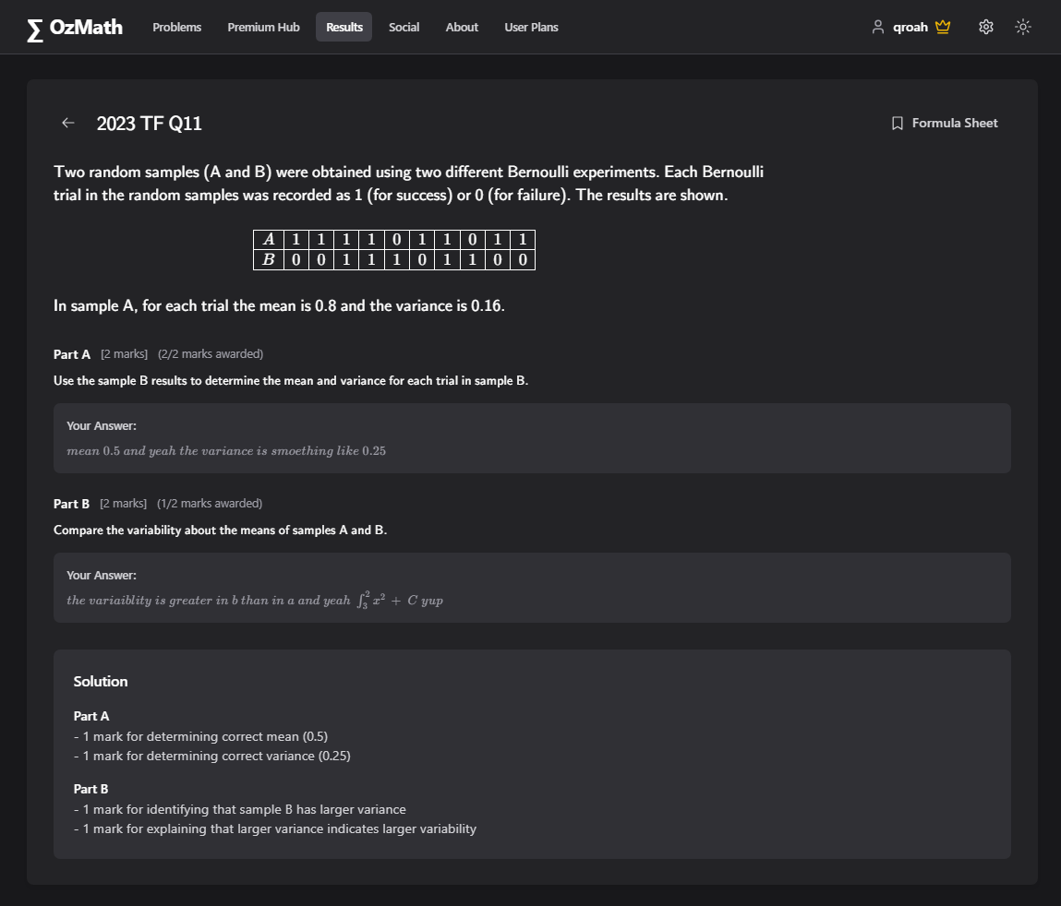



Testing system (2)
Fig. 10: Test Results Modal, Desktop POV
Fig. 11: Test Review Modal, Desktop POV
View results, review test see awarded marks & part marks
Fig. 12: Problem Review, Desktop POV

Slide 8
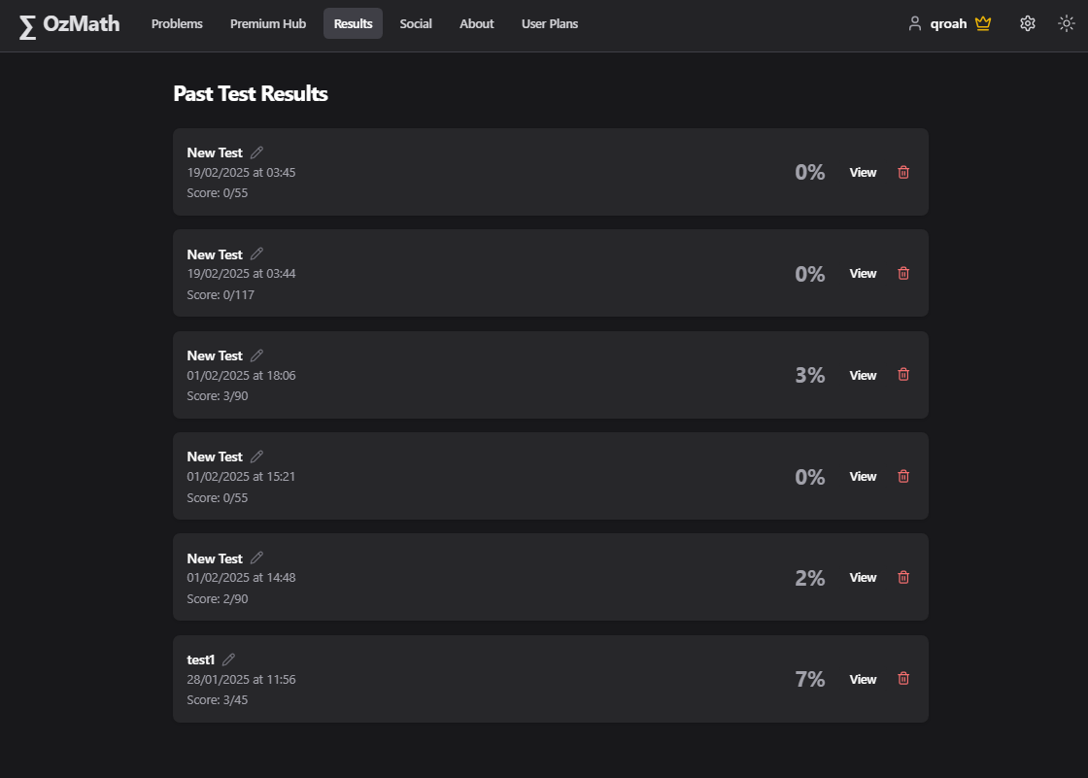
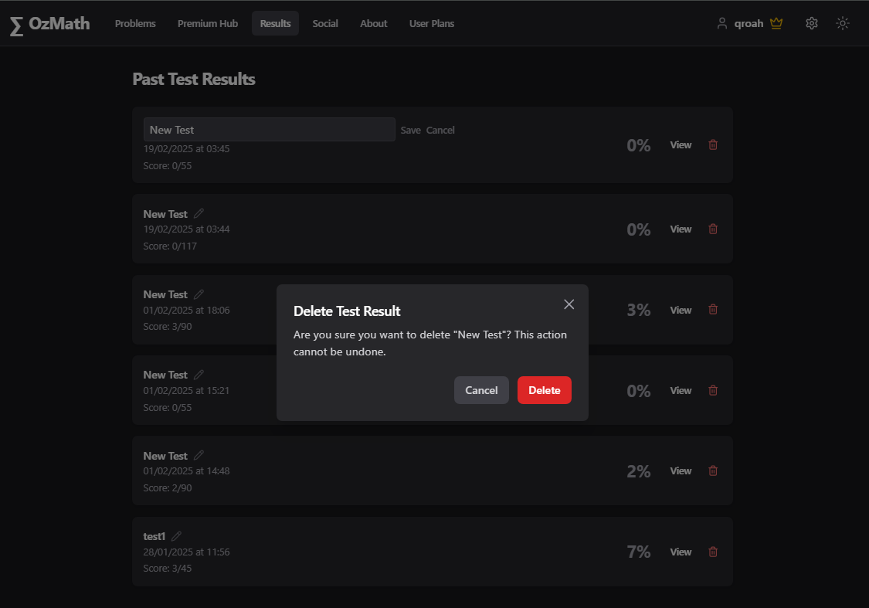



Testing system (3)
If a test is finalised by a registered user, tests can be reviewed again at any time in results tab
Able to rename, delete past tests
Fig. 13: Results Page, Tablet POV
Fig. 14: Results Page, Tablet POV

Slide 9
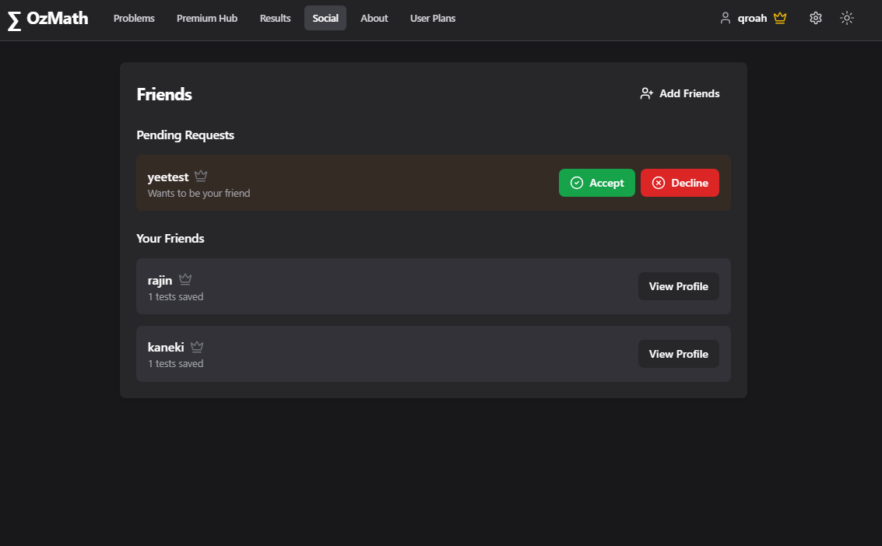
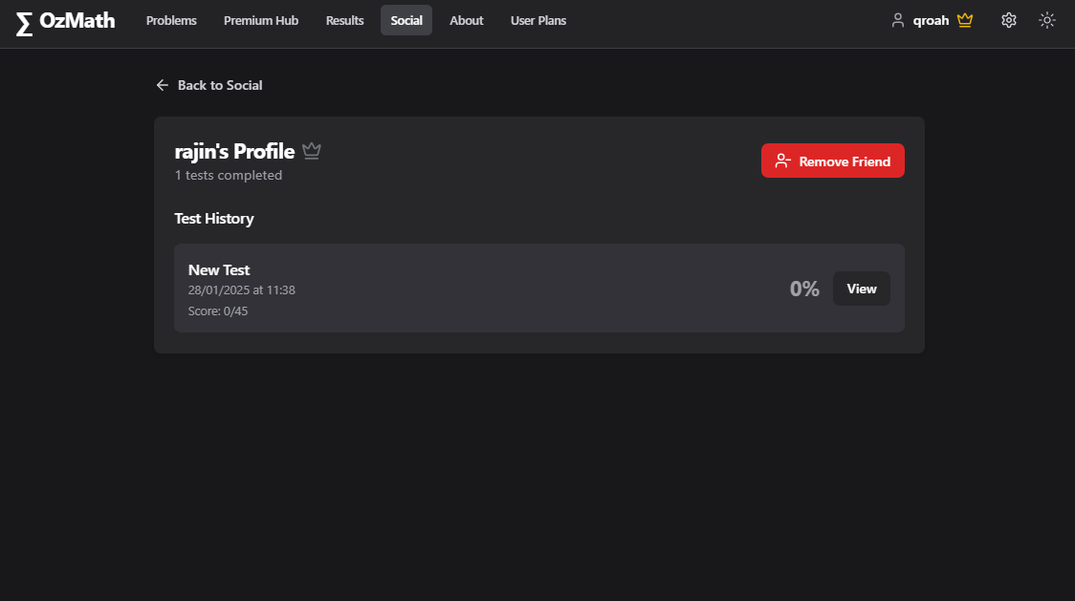

User & Social System
Registered users can add friends as well as view all their saved test results & answers
Database handling via Supabase in PostgreSQL
Fig. 15, Social Page, Desktop POV
Fig. 16: Social Profile View, Desktop POV

Slide 10
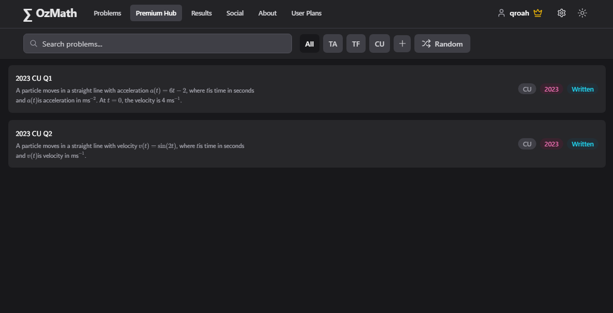
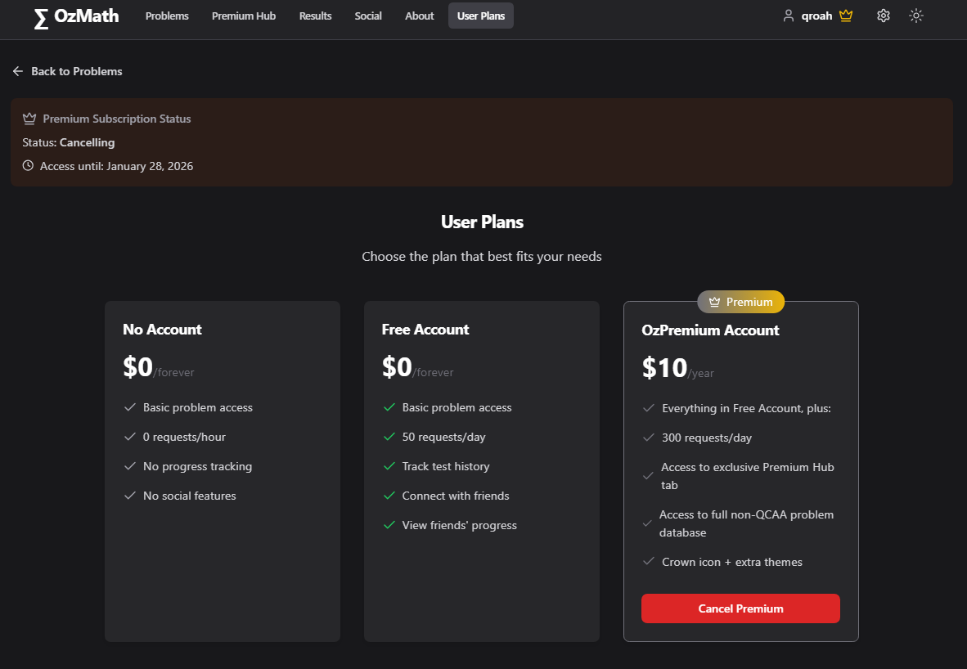
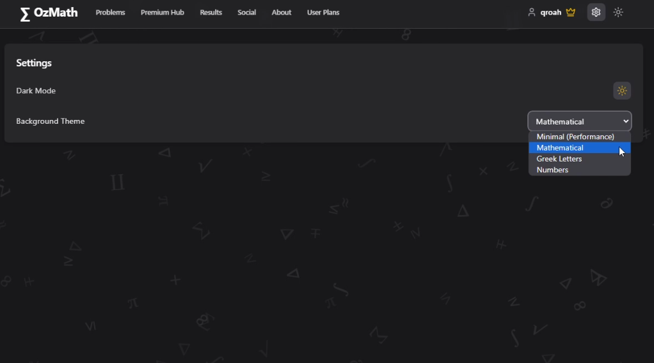

Premium Users & Features
Unlocks Premium Tab & more themes in settings
Payment handled by Stripe
Fig. 17: User Plans Page, Desktop POV
Fig. 18: Premium Hub + Settings Pages, Desktop POV

Slide 11
I originally began building OzMath in an effort to familiarise myself with new skills in web and full-stack development. However, as the project evolved with each new iteration, I found myself increasingly passionate and excited about its potential. This drive is explanatory of OzMath’s rapid development, and I’ve learnt a lot about entrepreneurial and development/revenue operations as a result.
I’m still working on OzMath and brainstorming new ideas every day, with plans to extend to other states, subjects and programs across Australia. Check the CHANGELOG.md file @ github.com/chaubenn/ozmath for more as this is where I log all changes first.
Stack/Languages/Technologies:
Typescript, React, MUX Video, Supabase, PostgreSQL, LaTeX, Tailwind CSS, HTML, GitHub Copilot, ChatGPT API, Radix/ui, Stripe, MathQuill, Netlify (deployment), Squarespace (domain host)
Inspirations:
Shadcn/ui (website layout, design, colour theme), MathMaster (mockups, layout), Leetcode (learning system, design), Math Videos Australia Joel Speranza (inspiration)
GitHub: @chaubenn
Website: ozmath.com

